Slide 1
LEXICAL ANALYSIS
Amartya Kundu Durjoy
Lecturer
CSE,UGV

Slide 2
Phases of a Compiler
Source program
Lexical analyzer
Syntax analyzer
Symbol table
manager
Semantic analyzer
Error handler
Intermediate code generator
Code optimizer
Code generator

Slide 3
The role of the lexical analyzer
First phase of a compiler
Main task
  To read the input characters
  To produce a sequence of tokens
    used by the parser for syntax analysis
  An assistant of parser

Slide 4
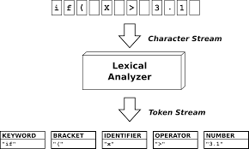
The role of the lexical analyzer

Slide 5
The role of the lexical analyzer
Interaction of lexical analyzer with parser
token
Source program
Lexical analyzer
Parser
Get next token
Symbol table

Slide 6
The role of the lexical analyzer
Processes of lexical analyzers: a cascade of two parts
  Scanning
    Pre-processing
      Strip out comments and white space
      Macro functions (replace/take action)
    Correlating error messages from compiler with source program
    A line number can be associated with an error message
  Lexical analysis

Slide 7
The role of the lexical analyzer
Terms of the lexical analyzer
  Token
    Types of words in source program
      Keywords, operators,
      identifiers, constants,
      literal strings,
      punctuation symbols (such as commas, semicolons)
  Lexeme
    Actual words in source program matched by pattern
      valid token
  Pattern
    A rule describing the set of lexemes that can represent a particular token in source program
    Relation {<.<=,>,>=,==,<>}

Slide 8
The role of the lexical analyzer
Example
Token
Informal description
Sample lexemes
if
Characters i, f
if
else
Characters e, l, s, e
else
relation
< or > or <= or >= or == or !=
<=, !=
id
Letter followed by letter and digits
pi, score, D2
number
Any numeric constant
3.14159, 0, 6.02e23
literal
Anything but “ sorrounded by “
“core dumped”

Slide 9
The role of the lexical analyzer
Attributes for Tokens
When more than one pattern matches a lexeme, the lexical analyzer must provide additional information about the lexeme
The token influences parsing decision and attribute influences translation of tokens
Token has single attribute namely pointer to the symbol table entry where information about the token is kept.

Slide 10
The role of the lexical analyzer
  E.g E=M*C**2 (written in FRTRAN)
  <id, pointer to symbol-table entry for E>
  <assign_op,>
  <id, pointer to symbol-table entry for M>
  <multi_op,>
  <id, pointer to symbol-table entry for C>
  <exp_op,>
  <num, integer value 2>

Slide 11
Specification of Tokens
Regular expressions are an important notation for specifying patterns.
Each pattern matches a set of strings, so regular expressions will serve as names for sets of strings.
Regular Definition of Tokens
  Defined in regular expression
  e.g. Id → letter(letter|digit)
  letter →A|B|…|Z|a|b|…|z
  digit →0|1|2|…|9

Slide 12
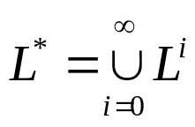
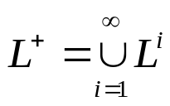
Specification of Tokens
Some definitions
  alphabet : a finite set of symbols. E.g. {a, b, c}
  A string over an alphabet is a finite sequence of symbols drawn from that alphabet (sometimes a string is also called a sentence or a word).
  A language is a set of strings over an alphabet.
  Operation on languages (a set):
    union of L and M, L U M = {s|s is in L or s is in M}
    concatenation of L and M
      LM = {st | s is in L and t is in M}
    Kleene closure of L,
    Positive closure of L,

Slide 13
Specification of Tokens
Notational Short-hands
  a) One or more instances
  ( r )⁺ digit⁺
  b) Zero or one instance
  r? is a shorthand for r|ε (E(+|-)?digits)?
  c) Character classes
  [a-z] denotes a|b|c|…|z
  [A-Za-z] [A-Za-z0-9]

Slide 14
Recognition of Tokens
Grammar:
stmt → |if expr then stmt
|if expr then stmt else stmt
|∈
expr → term relop term | term
term → id | num
Assume Following Tokens:
if, then, else, relop, id, num
Regular definitions
if ← if
then ← then
else ← else
relop ← < | <= | > | >= | = | <>
id ← letter ( letter | digit )*
num ← digit ⁺ (. digit ⁺ ) ? ( E(+ | -) ? digit ⁺ ) ?

Slide 15
Recognition of Tokens
Task of recognition of token in a lexical analyzer
  Isolate the lexeme for the next token
  Produce as output a pair consisting of the appropriate token and attribute-value, such as <id, pointer to table entry>

Slide 16
Recognition of Tokens
Task of recognition of token in a lexical analyzer
Regular expression | Token | Attribute-value
if | if | -
id | id | Pointer to table entry
< | relop | LT

Slide 17
Recognition of Tokens
Regular Expression
Token
Attribute-Value
ws
if
then
else
id
num
<
<=
=
< >
>
>=
-
if
then
else
id
num
relop
relop
relop
relop
relop
relop
-
-
-
-
pointer to table entry
pointer to table entry
LT
LE
EQ
NE
GT
GE

Slide 18
Example: Lexeme(1/2)
Divide the following C++ program into appropriate lexemes.
float limitedSquare(x)
{ float x
return (x <= -10.0 || x >= 10.0) ? 100 : x*x;
}
Answer
<float> <id, limitedSquaare> <(> <id, x> <)> <{> <float> <id, x> <return> <(> <id, x> <op,"<="> <num, -10.0> <op, "||"> <id, x> <op, ">="> <num, 10.0> <)> <op, "?"> <num, 100> <op, ":"> <id, x> <op, "*"> <id, x> <}>

Slide 19
Example: Lexeme(2/2)
Tagged languages like HTML or XML are different from conventional programming languages in that the tags are either very numerous (as in HTML) or a user-definable set (as in XML). Further, tags can often have parameters. Suggest and divide the following HTML document into appropriate lexemes.
Here is a photo of <b>my house</b>; <p><img src="house.gif"/><br/> see <a href="morePix.html">More Picture</a> if you liked that one.</p>
Answer
<text, "Here is a photo of"> <nodestart, b> <text, "my house"> <nodeend, b> <nodestart, p> <selfendnode, img> <selfendnode, br> <text, "see"> <nodestart, a> <text, "More Picture"> <nodeend, a> <text, "if you liked that one."> <nodeend, p>

Slide 20
Recognition of Tokens
Methods to recognition of token
  Use Transition Diagram
        Transition diagram for >=
Accepting state
start
>
=
0
6
7
return(relop,GE)
Start state
other
*
8
return(relop,GT)

Slide 21
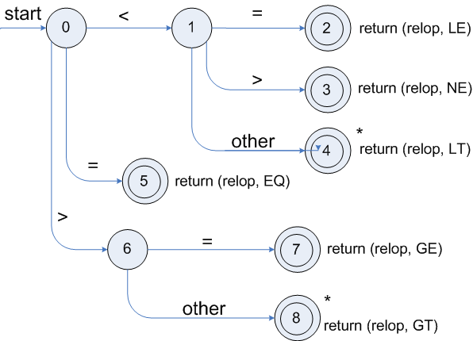
Recognition of Tokens
Transition diagram for relop

Slide 22
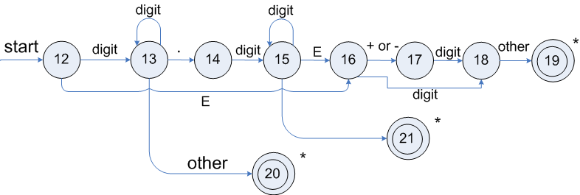
Recognition of Tokens
Transition diagram for unsigned numbers

Slide 23
Thank You

